Slide 1
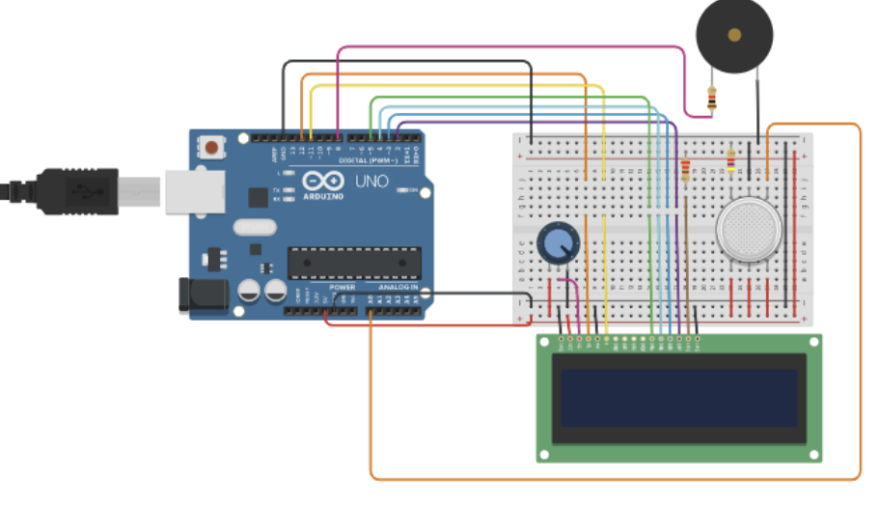
Air Pollution Detector Using Arduino UNO
A Smart Prototype for Monitoring Air Quality
2620030019 - Srisukta Hiranmayi
2620080077 - Jaya Haasika
2620030390 - Sreemayi
2620030014 – Akshitha Satwika
Circuit diagram

Slide 2
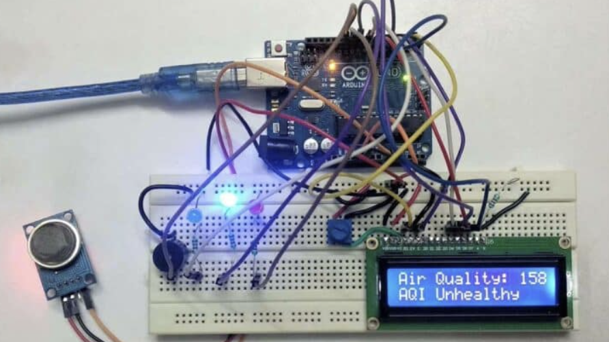
Introduction
Air pollution comes from vehicle emissions, industrial smoke, burning waste and harmful gases.
It affects human health and the environment.
This project is an Arduino UNO based prototype that senses gases and smoke in the air.
Readings are shown on an LCD screen.
Our prototype
2

Slide 3



Empathy: Who Is Affected?
Who is affected
What they feel
What they need
Children and elderly people
People with asthma
Traffic police and outdoor workers
Families near industries
Cough and breathing trouble
Eye and throat irritation
Headaches and tiredness
Worry about long-term health
A simple way to know when air is unhealthy
An affordable device
Clear and instant readings
3

Slide 4
Problem Statement
Vehicle smoke, industrial emissions and burning waste release harmful gases.
Many harmful gases cannot be seen or smelled.
People often notice the danger only after health effects begin.
Professional monitoring stations are costly and not available everywhere.
We need a low-cost way to monitor changes in air quality.
4

Slide 5
Why Arduino and Gas Sensors?
Low Cost
Easy to Build
Arduino and MQ sensors are cheap and easy to find.
Simple wiring on a breadboard, with easy programming.
Real-Time Readings
Expandable
Sensor changes appear on the LCD within moments.
New sensors, alerts and Wi-Fi can be added later.
5

Slide 6
Solution and Working
An Arduino UNO reads the signal from the MQ gas sensor placed in the air.
The Arduino processes the reading and shows it on the LCD.
A buzzer gives an alert when the reading is high.
Components: Arduino UNO, MQ gas sensor, LCD, buzzer, potentiometer, resistors, breadboard, jumper wires, USB cable.
Air
MQ Gas Sensor
Arduino UNO
Data Processing
LCD Display + Buzzer
6

Slide 7
Result
Test Condition | Sensor Reading | LCD Output
Clean air (baseline) | To be measured | To be measured
Safe smoke source | To be measured | To be measured
Other safe test | To be measured | To be measured
Working prototype with LCD output
Enter only actual measured values. Readings are not calibrated pollutant concentrations.
The LCD shows the sensor reading and an air-quality status.
Values change when the sensor is exposed to smoke or gases.
7

Slide 8
Advantages and Future Scope
Advantages
Future Scope
Low-cost prototype
Easy to assemble with common parts
Real-time readings on the LCD
Buzzer alert for high readings
Good for learning and demos
Wi-Fi or Bluetooth connectivity
Store readings and plot graphs
Calibrate sensors for reliable estimates
Add more sensors (dust, temperature)
Mobile app alerts
8

Slide 9





Conclusion
The project shows air-quality monitoring using Arduino UNO.
The MQ gas sensor responds to gases and smoke.
Readings appear on the LCD, and the buzzer alerts on high values.
It is a useful learning platform for electronic monitoring systems.
Future upgrades can make it more informative and reliable.
Arduino
MQ Sensor
Clean Air
Environment
Health
Thank You!
Any Questions?
9

